Slide 1
Active Learning Strategies
Sandy Greene and Katie Hopkins
University 101 Programs
University of South Carolina

Slide 2
60-60-30-30
Question One (60 Seconds): What active learning strategies have you used?
Question Two (30 Seconds): In what ways did those active learning strategies help your students learn?

Slide 3
Case Studies
QUESTION: How can you use case studies in your classes?

Slide 4

One Minute Paper

Slide 5
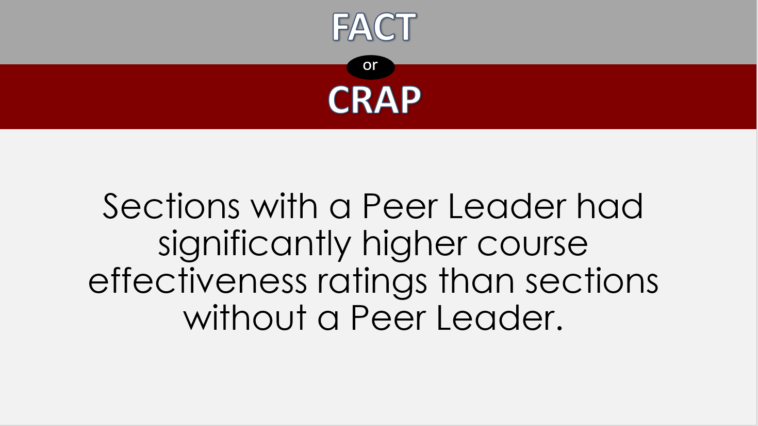

Fact or Crap

Slide 6

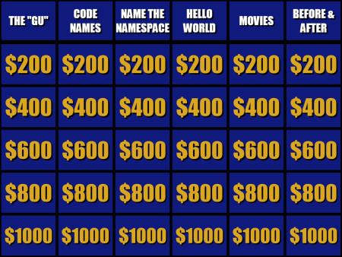
Game Show

Slide 7
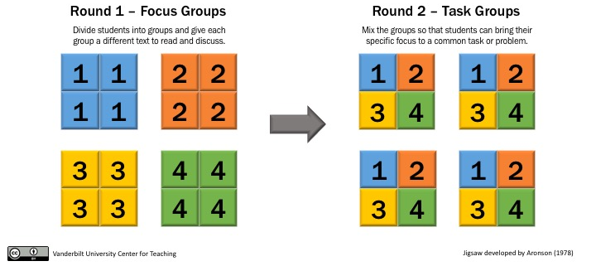
Jigsaw

Slide 8

Peer Review

Slide 9
Think-Pair-Share
What obstacles are there to using active learning strategies and what can you do to overcome those obstacles?

Slide 10
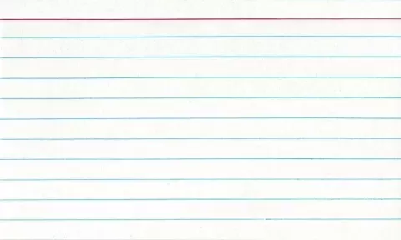
Notecard Takeaway?
What is your biggest takeaway from this presentation?
What is one active learning strategy you are committed to using in your class?

Slide 11
Questions?
Notes:
Katie

