Slide 1
Unlocking Biology for All: Universal Design for Learning in the Life Sciences
Dr. Charles A. Schumpert
Dr. Amanda P. Zeigler
Notes:
Amanda

Slide 2
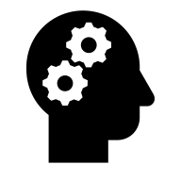
Session Outcomes
By the end of this session, participants will be able to:
Identify the guiding principles of universal design for learning (engagement, representation, and action & expression).
Identify potential barriers to learning that students in STEM disciplines may face (e.g., complex terminology, reliance on a single mode of content delivery, high cognitive load) and propose UDL-informed strategies to reduce or remove them.
Reflect on how UDL approaches can support students by enhancing engagement, comprehension, and retention for all learners in the biology classroom.
Notes:
Amanda

Slide 3
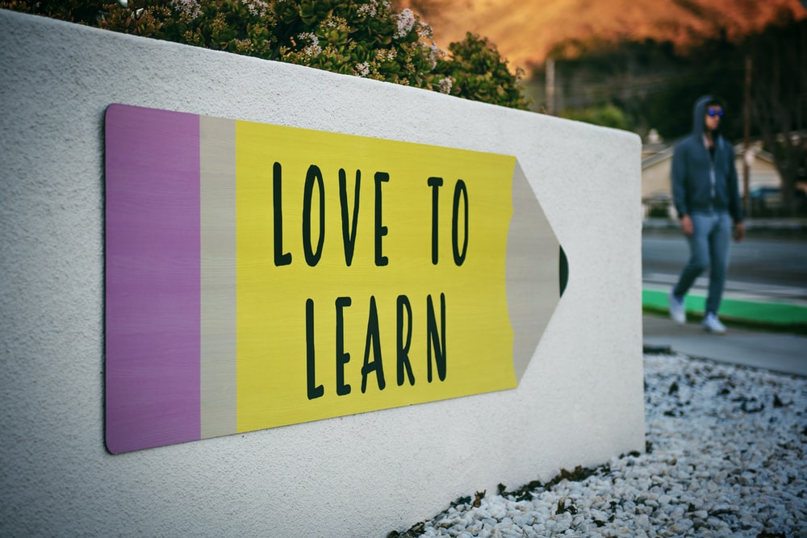
Session outline
What is UDL?
How did we implement UDL in our Biology classes.
Celebrations and Challenges
Future Directions
Enhancing supportive environments for students
Notes:
Image from Unsplash: Tim Mossholder
Amanda

Slide 4
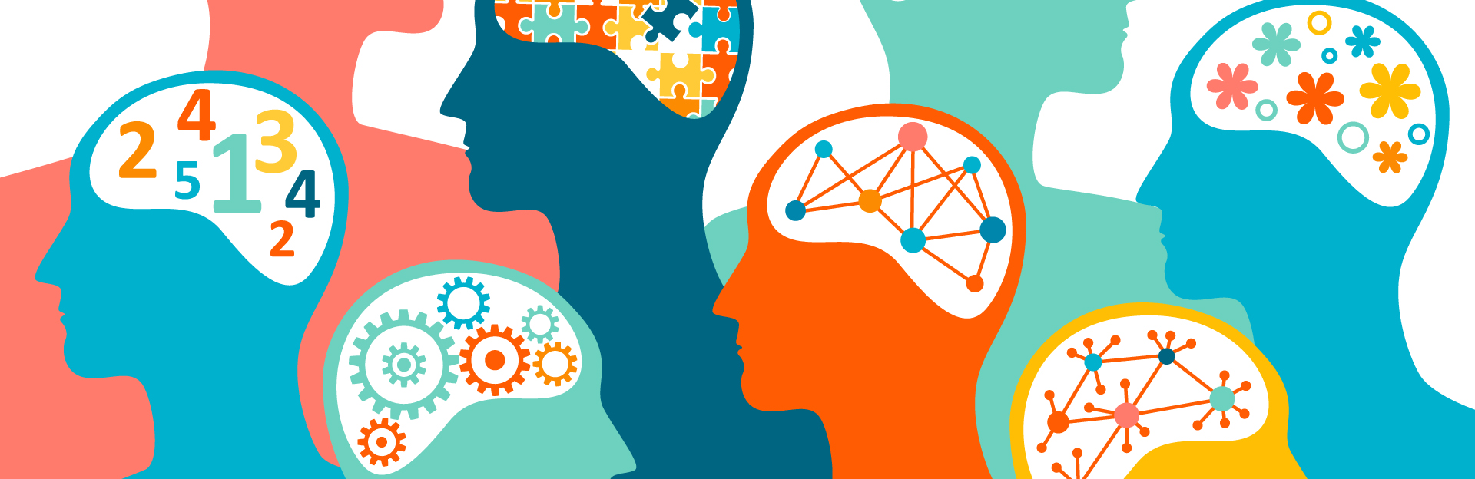
What is UDL?
Definition (Center for Applied Special Technology, CAST):
“UDL is a framework to improve and optimize teaching and learning for all people based on scientific insights into how humans learn.”
It aims to create learning environments that are inclusive, flexible, and accessible for all students from the start.
https://njedge.net/blog/improving-accessibility-through-the-universal-design-for-learning/
Notes:
Andy

Slide 5
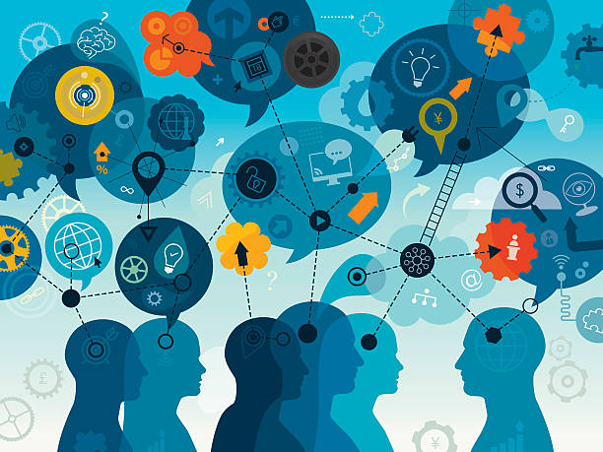
Origins and Framework of UDL
Universal Design emerged in the field of architecture in the 1970s and 1980s.
In the 1990s, researchers at CAST applied the universal design concept to education.
Utilizing neuroscience research, CAST proposed that learners vary widely in:
How they engage with learning
How they take in and process information
How they demonstrate understanding
https://www.istockphoto.com/vector/webinar-concept-gm498688500-79779937?searchscope=image%2Cfilm
Notes:
Andy

Slide 6

Think-Pair-Share
Please take a moment to chat with your neighbors:
Why does UDL seem like a nebulous concept?
How can we fit it to our own classroom needs?
Notes:
Andy

Slide 7
Principles of UDL
CAST developed the UDL Framework around these three principles:
1) Multiple Means of Engagement: the why of learning
2) Multiple Means of Representation: the what of learning
3) Multiple Means of Action and Expression: the how of learning
Notes:
Amanda

Slide 8

Why is UDL important?
1. It promotes Equity and Inclusion
UDL proactively designs for variability to ensure everyone has equal opportunities to succeed.
https://www.istockphoto.com/vector/education-integrated-thin-line-symbols-gm519623760-90634779?searchscope=image%2Cfilm
Notes:
Amanda

Slide 9
What is Equity in Education?
An equitable classroom:
Is tailored to individual student needs.
Biochemistry Example.
Encourages connections between the student and instructor.
Instructors need to know their students.
Instructor acknowledges all students in the classroom.
Material covered in the class is from diverse individuals (Representation matters!)
What are some barriers to an equitable classroom?
Access to materials!
Notes:
Andy

Slide 10
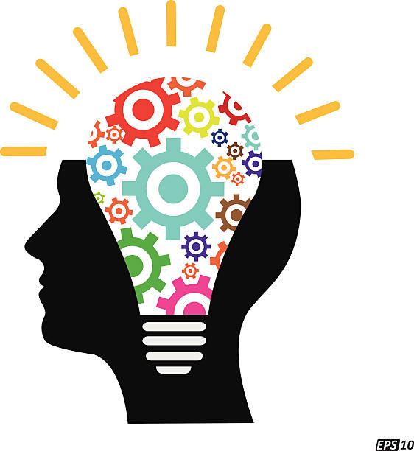
Why is UDL important?
2. It Supports All Types of Learners
UDL principles recognize that students differ in:
How they engage with (motivation, interest), receive (visual, auditory, kinesthetic), and express what they know (writing, speaking, creating).
https://www.istockphoto.com/vector/creative-idea-or-thinker-gm534704013-56647770?searchscope=image%2Cfilm
Notes:
Andy

Slide 11
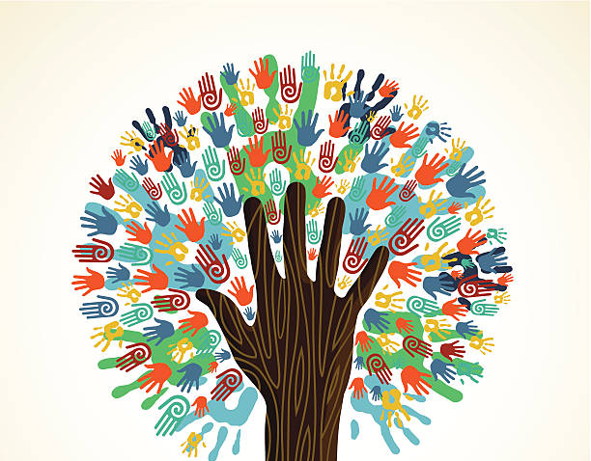
Why is UDL important?
3. It Reduces the Need for Accommodations
Designing courses with UDL in mind, fewer adjustments are needed.
This reduces barriers for students before they occur!
https://www.istockphoto.com/vector/diversity-tree-hands-illustration-gm151902402-21138449?searchscope=image%2Cfilm
Notes:
Amanda

Slide 12
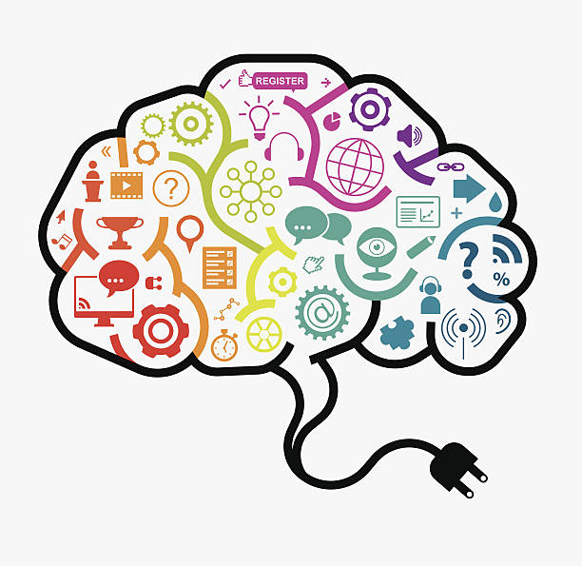
Why is UDL important?
4. It Improves Learning for Everyone
Examples:
Captioned videos.
Clear instructions and varied formats benefit all students.
https://www.istockphoto.com/vector/webinar-brain-concept-gm517255141-49136750?searchscope=image%2Cfilm
Notes:
Amanda

Slide 13
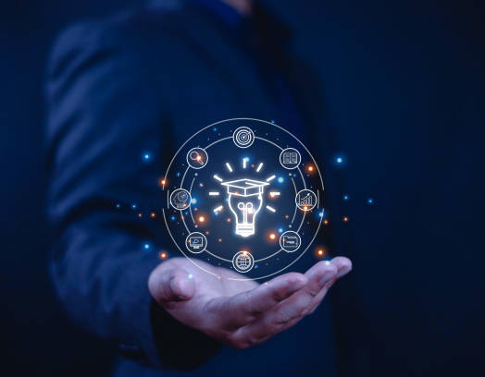
Why is UDL important?
5. It Encourages Reflective and Adaptive Teaching
UDL encourages educators to ask:
“Who might be left out of this design?”
“How can I teach this in multiple ways?”
This fosters more intentional, learner-centered pedagogy.
https://www.istockphoto.com/photo/e-learning-concept-businessman-showing-e-learning-icons-on-hand-learning-online-gm2198110043-616007231?searchscope=image%2Cfilm
Notes:
Andy

Slide 14

Why is UDL important?
6. Aligns with Institutional Goals
Compliance with the Americans with Disabilities Act (ADA) and Section 504.
Supports access and opportunity initiatives.
UDL provides a practical framework to achieve those goals.
https://www.istockphoto.com/vector/set-of-flat-design-icons-for-education-gm524424351-51838744?searchscope=image%2Cfilm
Notes:
Andy

Slide 15
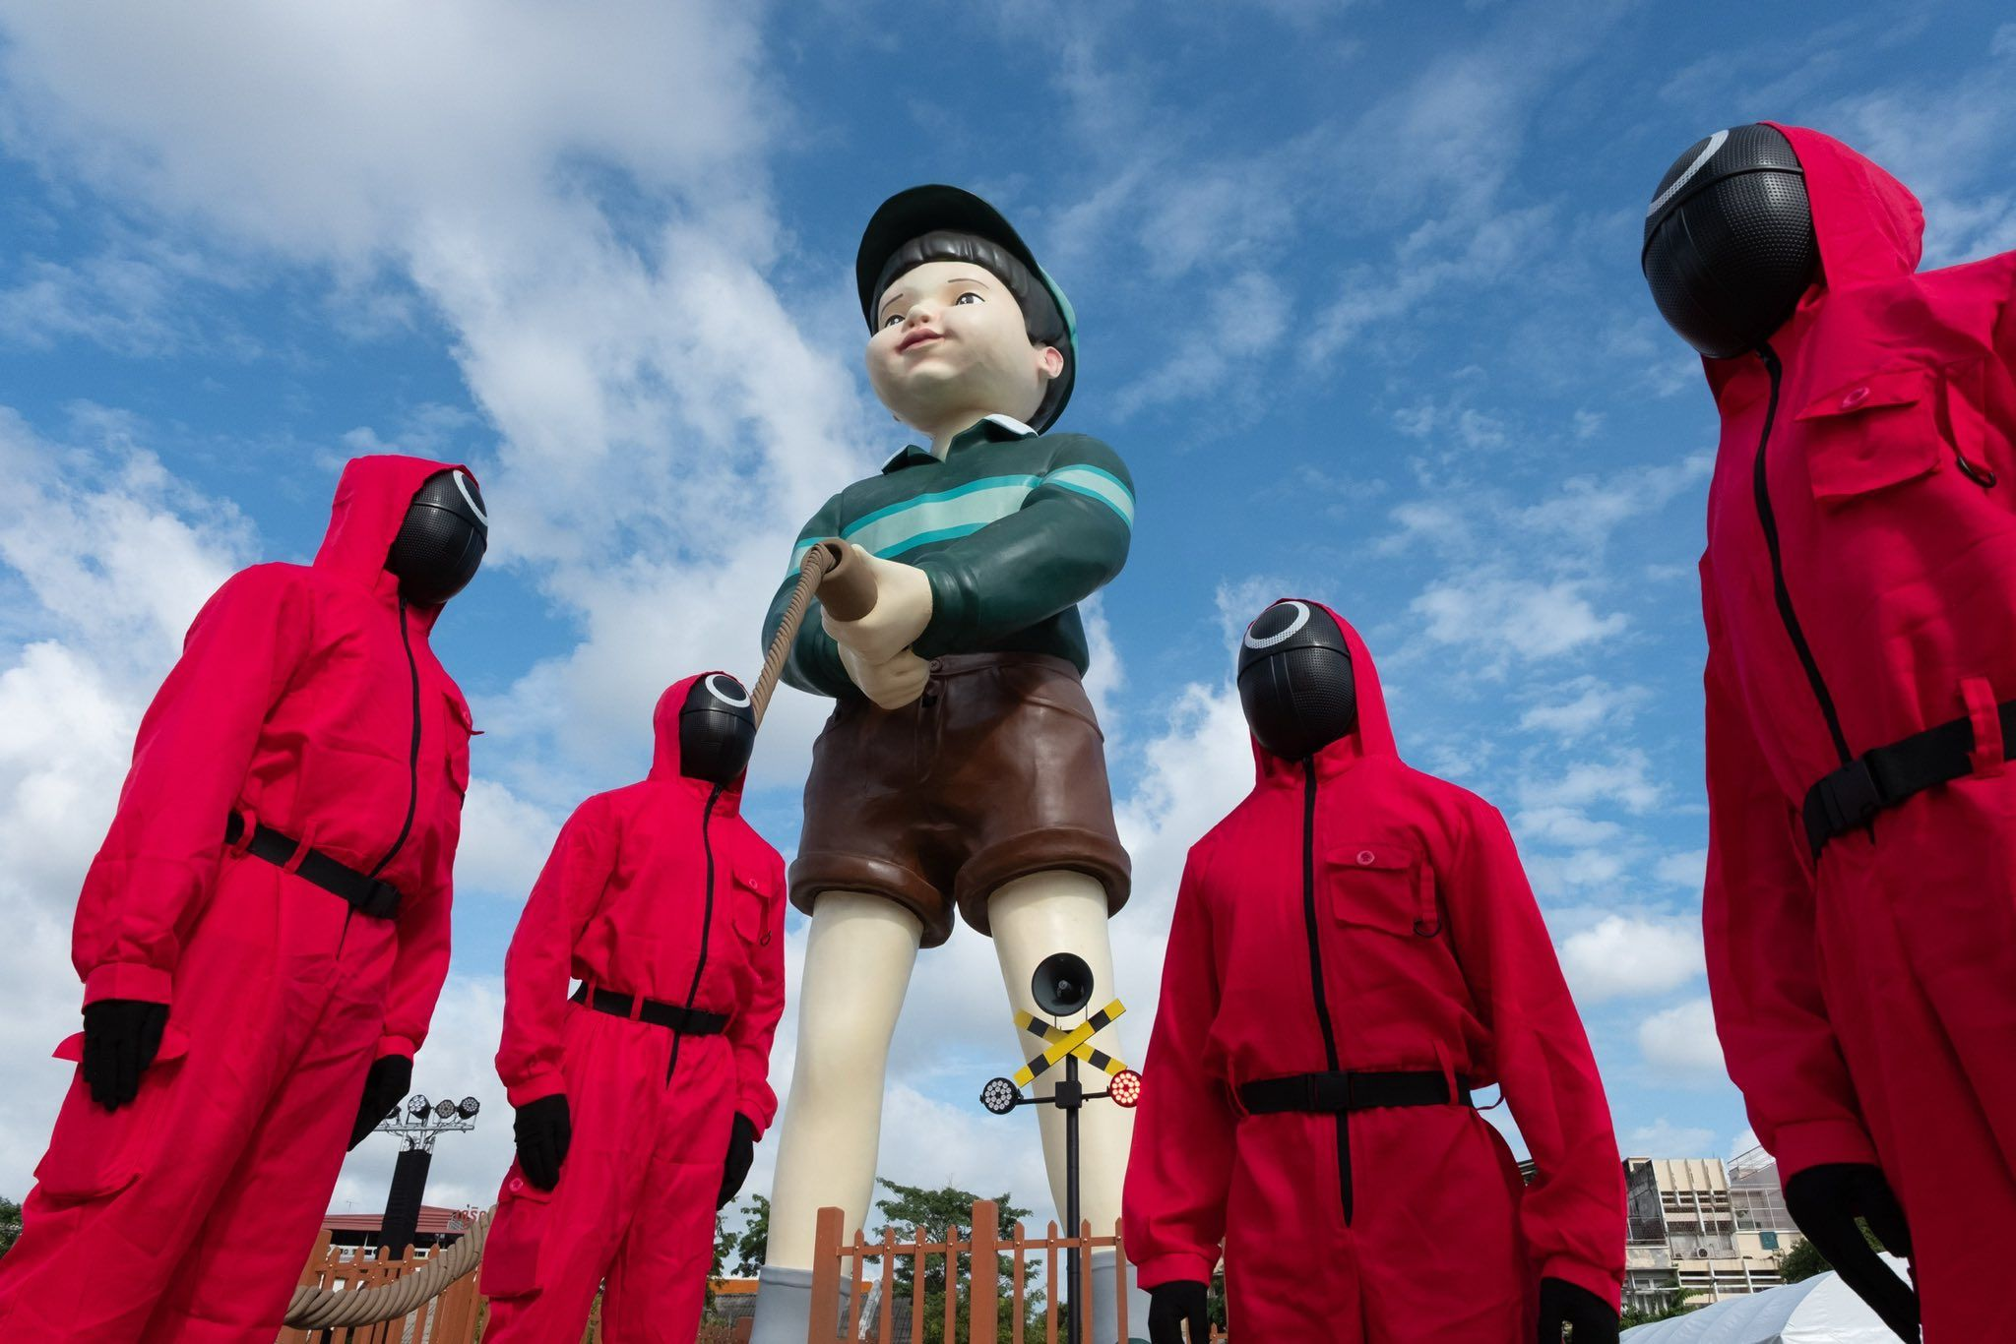
Who Wants to Play a Game?
Kahoot!
Notes:
Amanda
https://create.kahoot.it/share/udl-engagement/bf3cab6e-9b0f-4113-af35-5e412e001079

Slide 16
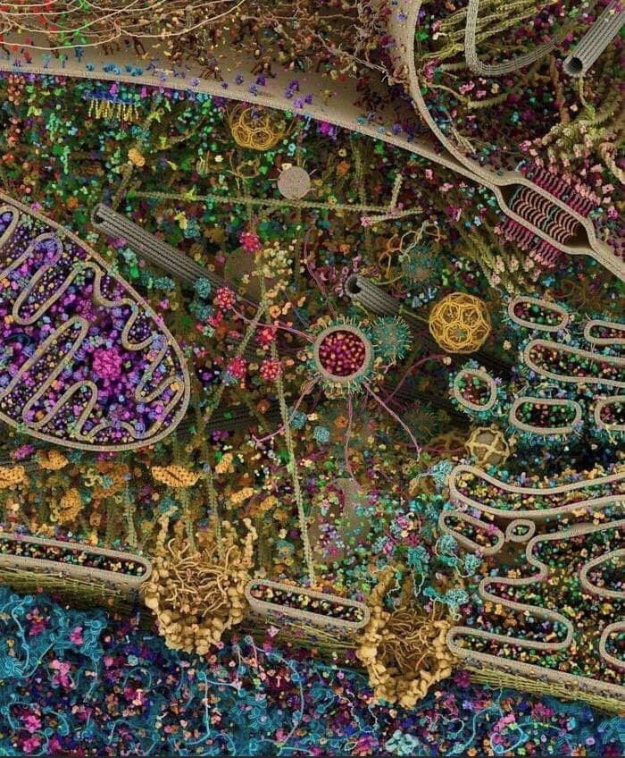
UDL in BIOL 302: Cell and Molecular Biology
Accessibility
Live Captions
Dyslexia friendly fonts (Arial, Helvetica)
Graphical Syllabus
Engagement
Active Learning (Think-Pair-Share, Lightening Rounds, Memory Dumps, Sorting Sequences, and more!)
Surveys and feedback
Student Resources (Peer Circles, Exam Prep-Self Reflection Surveys)
Notes:
Amanda

Slide 17
UDL in BIOL 302: Cell and Molecular Biology
Representation
Inclusive language
Student Gallery Projects
Action and Expression
Inclusive exam expression (providing multiple question types)
Assessment wrappers (Muddiest Point)
Notes:
Amanda

Slide 18
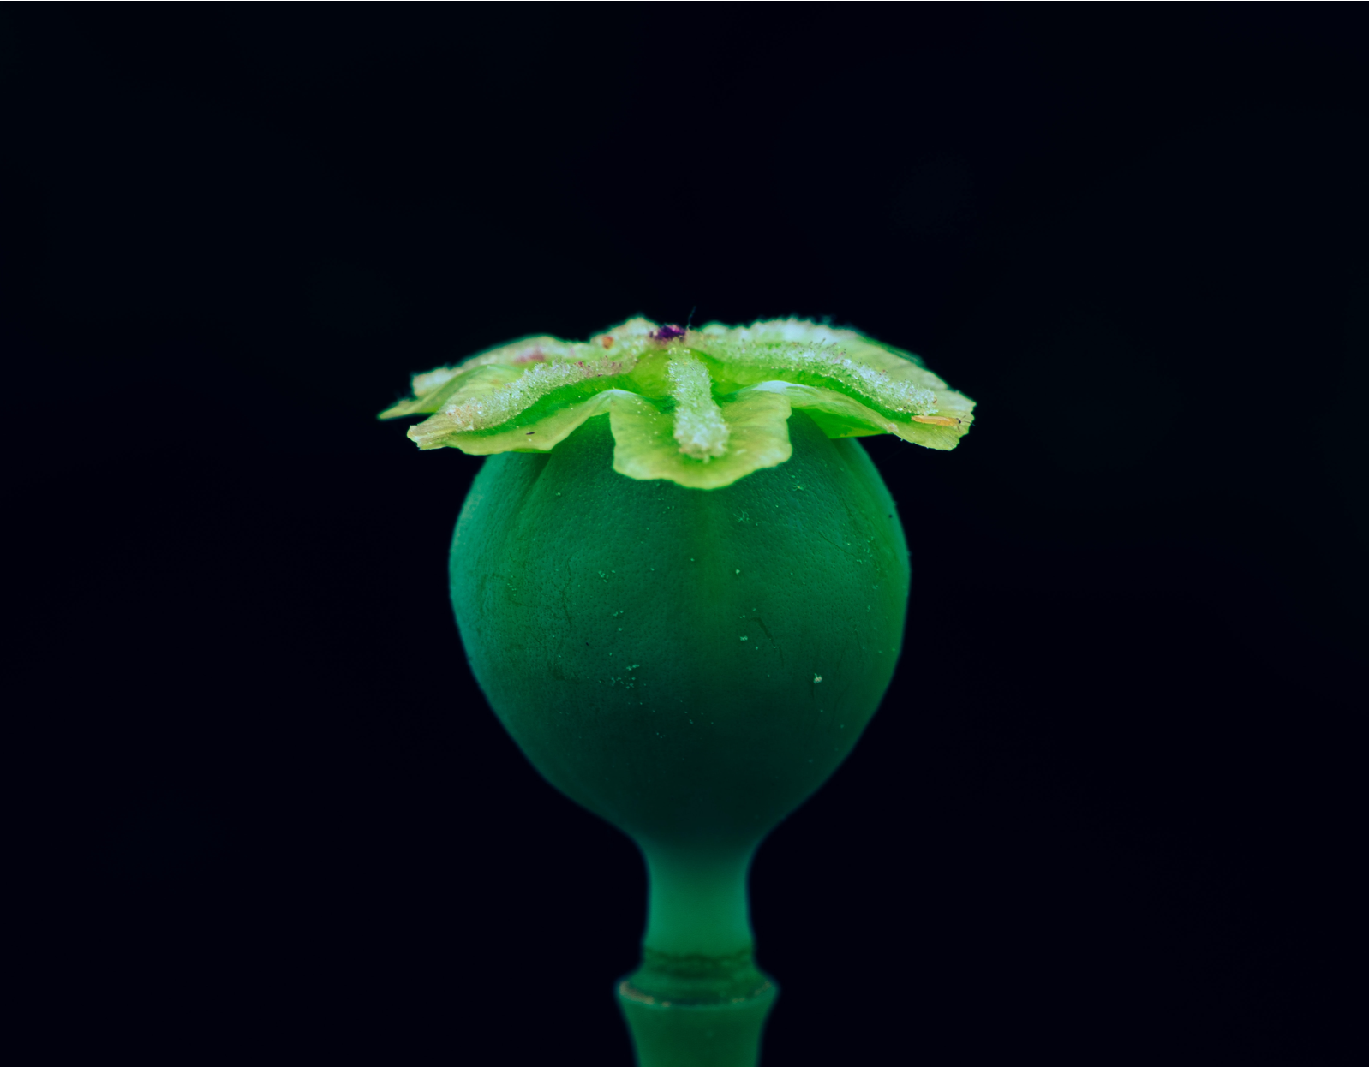
UDL in BIOL 423: Medicinal Botany
Accessibility
Live Captions
Dyslexia friendly fonts
Color blind Colors
Ally on Blackboard
Student Resources
Engagement
Online Community
Student Response/Active Learning
Surveys and feedback
Notes:
Andy

Slide 19
UDL in BIOL 423: Medicinal Botany
Representation
Intentional Celebration
Inclusive language
Personal Journey
Action and Expression
Inclusive exam expression
Assessment wrappers
Big Picture Ideas
Notes:
Andy

Slide 20

Future Directions
UDL in more labs.
BIOL 302 Lab.
BIOL 102 Lab.
BIOL 243, 244 Labs.
UDL in more lectures.
BIOL 541.
BIOL 303.
Beyond.
Other equity enhancing adjustments
Notes:
Image from unsplash: Wonderlane
Andy

Slide 21
One Minute Reflection
What’s your takeaway from our session today? Reflect!
Take a moment to let your mind wander.
Notes:
Image from unsplash: Wonderlane
Amanda

Slide 22
Any Questions?
Charles A. Schumpert, PhD
Senior Instructor
Department of Biological Sciences
schumpca@email.sc.edu
Amanda P. Zeigler, PhD
Director of Undergraduate Studies
Department of Biological Sciences
Email: polsona@mailbox.sc.edu
Notes:
Both

