Slide 1
Managing Hands-On
Group Projects in Large Classrooms
Dr. Anli Xiao
Assistant Professor
School of Journalism and Mass Communications
College of Information and Communications
University of South Carolina

Slide 2

About Me
Assistant Professor at School of Journalism and Mass Communications, College of Information and Communications
10 years of teaching large classes, 8 years in higher education
At least one large class per semester
20 groups in one class last semester; 2 real clients

Slide 3
Large classes & group work challenges
In a group of 2-3, discuss what challenges do you see/have you experienced with group work in large classes?

Slide 4
Large classes & group work challenges
Free riders/student accountability
Conflict management
Coordination, communication, managerial work
Keep track of group progress
Crappy quality
Students think the group project has no real purpose and thus, are not motivated
Managing clients and their expectations
Limited resources

Slide 5
Classes I have taught
Social media planning (80-100+)
Social Media Research & analytics (40ish)
Public Relations principles (80+100+)
Research methodologies (40)
80 to 100+ students per semester
A very challenging class with that class size
  Limited resources
  Lack of hands-on opportunities for the class size
  Planning is boring – when you don’t get to execute your plan
99 students & 20 groups last spring (one large group project as their final project)
2 clients (one for project, one non-profit)

Slide 6
What worked
Managing student expectations
  Started on Day One
  It’s not a “final project”
  Share the challenges & Invite them to be part of the solution
Help them to learn group work management
  Leave enough class time for group work
  Specify the use of class time
  Encourage/help them to establish proper communication channels and shared workspace
  Establish group work expectations

Slide 7
What worked
Giving out instructions for the class project early (even if they don’t need to start now)
Keeping track of groupwork & communication
  Check-ins
  Blackboard Cafe
Conflict resolution
  Peer review %
  The alternative option (that no one wants to take)
  Conflict prevention
Keeping it real – real clients & real challenges
Offer additional resources – even if they aren’t highly accessible

Slide 8
Things to try
“This is a semester long project”
Be transparent and ask for assistance
  “I need your help. Here is the situation…what do you suggest?”
  “Group work can be very challenging. What can we do to make sure everyone contributes fairly?”
Invite feedback early during group work

Slide 9
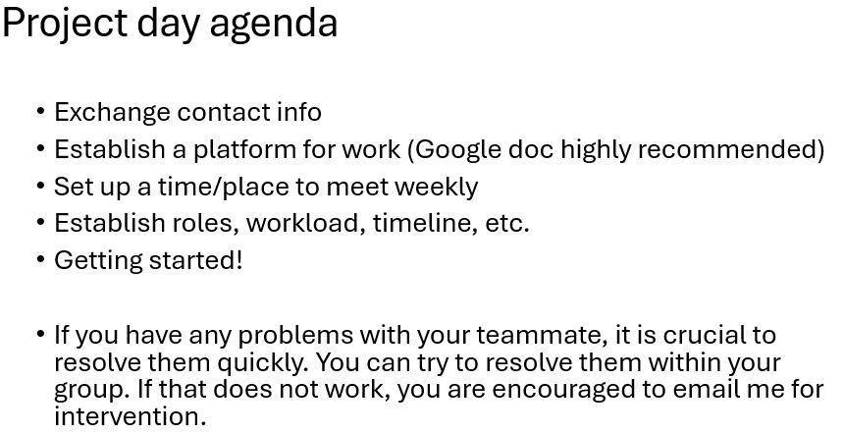
Things to try
For in-class group work time, provide group work agenda and check-ins:
“I will go to each group and discuss your progress with you guys and take notes”

Slide 10
Things to try
A group contract (?) for conflict prevention

Slide 11
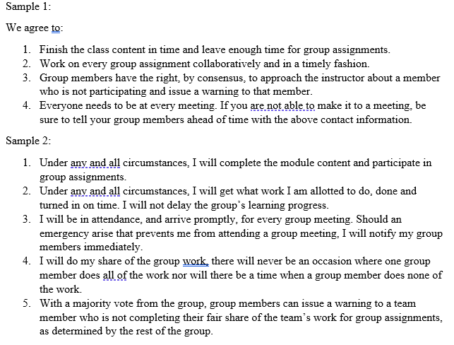

Slide 12
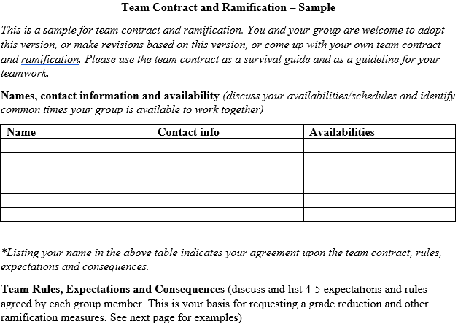

Slide 13
Things to try
Conflict resolution
“If you believe you aren’t the best at group work, you have the option of finishing the work by yourself.”
“If your group mates believe that the group functions better without you, you might need to finish the group work all by yourself.”

Slide 14
Things to try
Invite real clients, but keep the scope of work small
  1-2 real challenges/events/problems
  Incentivize them by using what they proposed

Slide 15
Discussion
Pairing activity
In a group of 2-3, think of how the things I have suggested may help you to manage your group work challenges in classrooms

Slide 16
Free riders/student accountability
“This is a semester long project”
Conflict management
Be transparent and ask for assistance
Coordination, communication, managerial work
Invite feedback early during group work
Group work agenda and check-ins
Keep track of group progress
Group contract
Crappy quality
The alternative option
Students think the group project has no real purpose and thus, are not motivated
Real clients & 1-2 challenges
Managing clients and their expectations
Incentivize by applying what they proposed
Limited resources

